Slide 1
Combining Evidence
Machine Learning and Predicting Clinical Diagnoses / State
Dan W Joyce

Slide 2
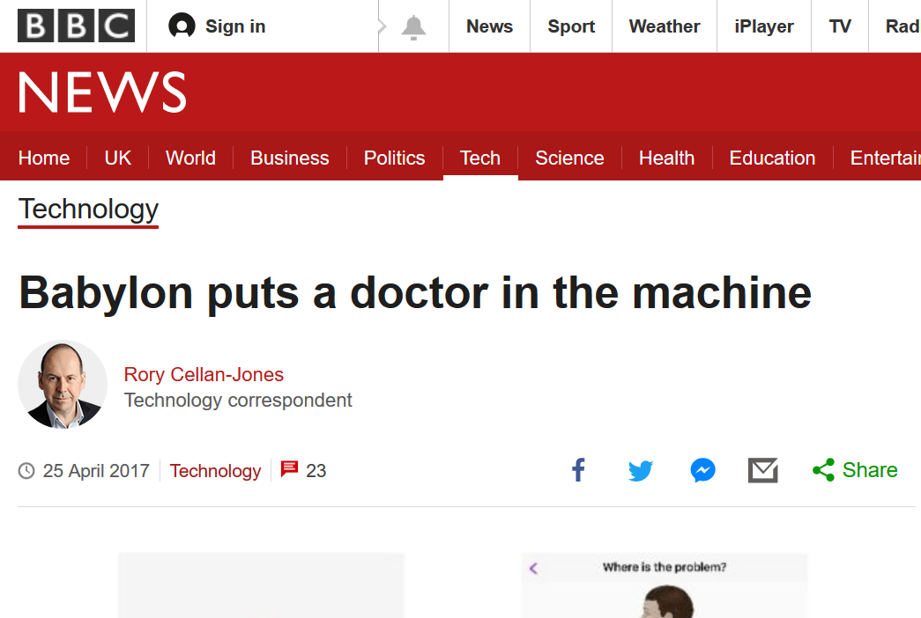
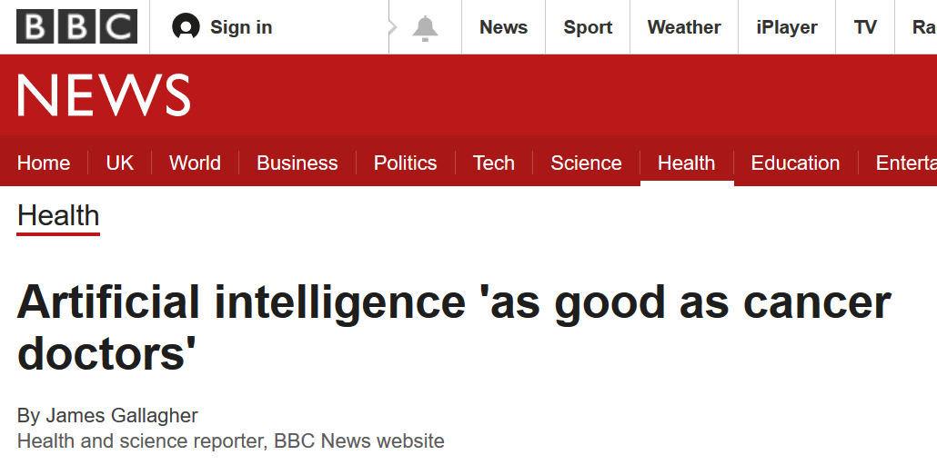
The Hype
Babylon is announcing an investment of £50m to build what it claims will be the world's most advanced artificial intelligence healthcare platform.
Its chief executive Ali Parsa says … "Our scientists have little doubt that our AI will soon diagnose and predict personal health better than doctors," he says.
Dr Jana Witt, from the charity Cancer Research UK, said … "It's unlikely that AI will replace all of the other information your clinician would consider when making a diagnosis, but AI could help guide GP referrals to specialists in the future."
Brett Kuprel, another researcher on the project, added: "The end-to-end training and transfer learning approaches we used can be applied to many problems in healthcare, provided there is a large enough dataset.”

Slide 3
An Information Processing Model of Clinicians
Belief in Diagnosis
X
Dr
Dr
Dr
Dr
Y
Referral
Exam
Z
Notes:
3

Slide 4
Building a Single “Expert” (= Modality)

Slide 5
Pattern Classification
Classify flower species on the basis of petal width and sepal length (Fisher, 1936)
Simple 2D (planar) feature space
Feature Space
Linear decision boundary (surface) described by:
Sepal Width
Given a new sample: decide on it’s classification by
calculate y
If y > threshold : setosa, else versicolor/virginica
Sepal Length

Slide 6


Discovery (inference) vs Prediction
Data
Model Assessment
Model Fit
Hypothesis test for non-zero regression coefficients
“Biomarker predicts Severity”

Slide 7
Discovery (inference) vs Prediction
Prediction
Training
Model Fit
Model
Prediction Error
Validation
Model
Assessment

Slide 8
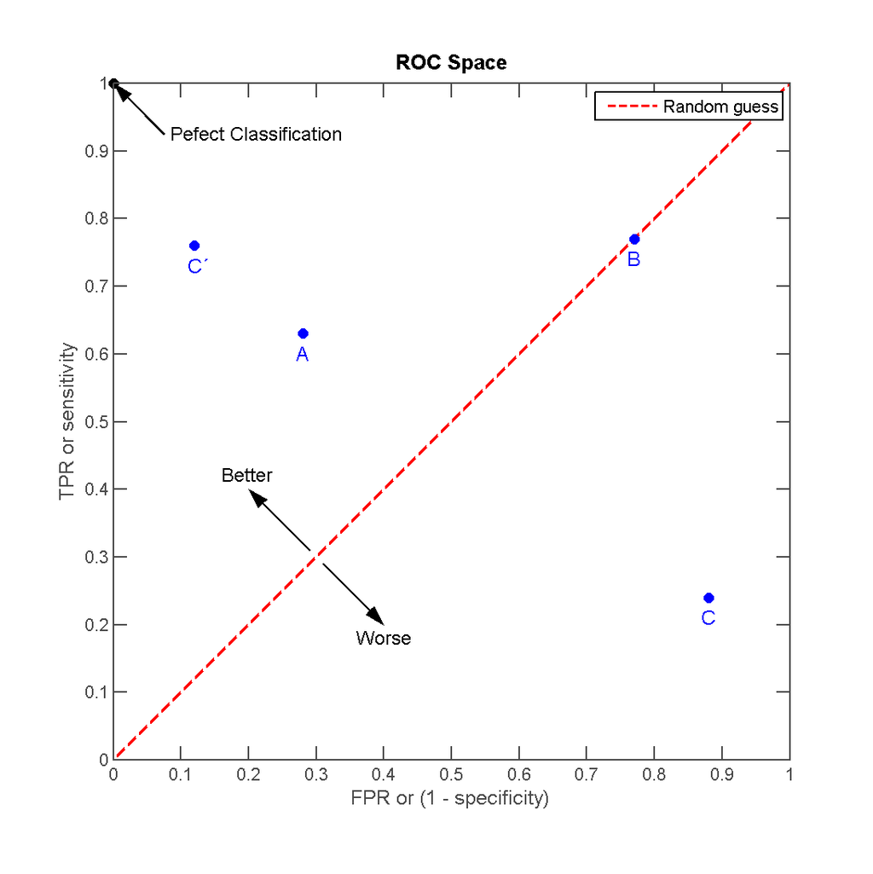
Assessing Performance from Prediction Error
TPR = Sensitivity
  TP : Test +ve and patient has disease
FPR = (1-Specificity)
  FP : Test +ve but patient does not have disease
Accuracy : (TP + TN) / N
  Good summary, but doesn’t tell us about clinically meaningful errors (FP and FN)
B
A
C
True Positive Rate
D
False Positive Rate

Slide 9
An Example: Alzheimer’s Dementia

Slide 10
Incomplete Data (Biomarkers)
n = number of subjects
p = size of feature space
121 patients “overlap” …
MRI
And … Gene Expression
And … Proteomics
Call this
“Brute Force” Combination

Slide 11
Classifying Patients as AD, MCI or Controls
How to make use of partial data?
… In a way we could deploy in diagnosis
How to learn which genes/proteins/MRI features predict AD ?
The “MDT” approach … combining evidence from multiple “experts”
The “classic” machine learning approach
Can potentially use all data
Can only use data for which all patients have all biomarker / modality data

Slide 12
A Problem with Brute Force Combination
Do not allow equivocation
Introduce ‘equivocal’ class

Slide 13
So far …
All our examples have been 1 or 2 dimensional
  MRI data : natively 10⁵ - 10⁶ voxels
  Proteomics / gene-expression : 10³ – 10⁴ for “off the shelf” arrays/chips
“Brute force” combination by “bolting” feature spaces together could lead to distortion in the joint feature space
And subjects need to have all biomarkers available = only 121 subjects
  Throwing away data from over 500 subjects
  If a subject has GX and PX, but not MRI, 25% of the subject’s data is systematically missing
  ?Implausible amount of imputation

Slide 14
Individual Classifiers
Brute force combination (versus individual biomarkers) does well but remember, performance can only be evaluated on the subset of 121 patients with all biomarkers

Slide 15
How to Combine Evidence : Majority Voting
Individual Votes
X
Y
Z
A
A
C
A
A
Dr
A

Slide 16
How to Combine Evidence : Averaging
X
Y
Z
A
Dr

Slide 17


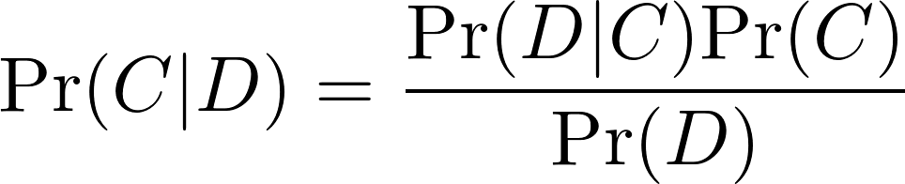
How to Combine Evidence : Probabilistic
X
Y
Z
A
Dr
Posterior Probability

Slide 18
Advantages
Probabilistic methods
  If a biomarker is missing, the classifier (expert) says “I don’t know, but here’s my prior”
  Principled way of combining evidence (SDT / Bayes) accounting for weight
Averaging methods –
  No principled was of saying “I don’t know”
  Accounts for “weight” offered by expert
Voting methods –
  Principled … if you believe in democracy
  Ignores “weight” offered by an expert
Brute Force – can’t help at all

Slide 19
Results
Brute force combination only evaluated on the subset of 121 patients with all biomarkers

Slide 20
A Closer Look
Controls
Alzheimer’s
MCI

Slide 21
More Data = Better Performance ?
Controls
Alzheimer’s
MCI

Slide 22
What’s the best combination ?
Controls
Alzheimer’s
MCI

Slide 23
Thank you …
Questions ?

Slide 24
A Brief, Potted History of
Pattern Classification,
Machine Learning and AI

Slide 25


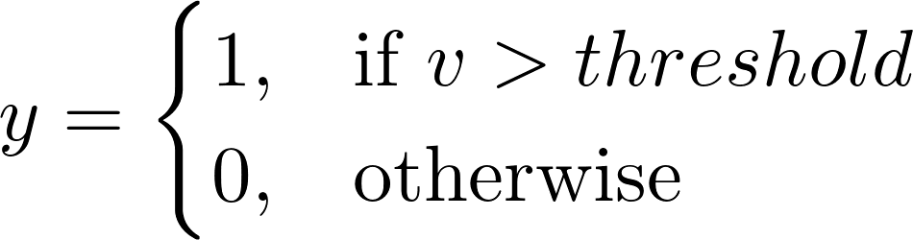


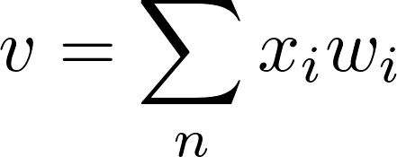
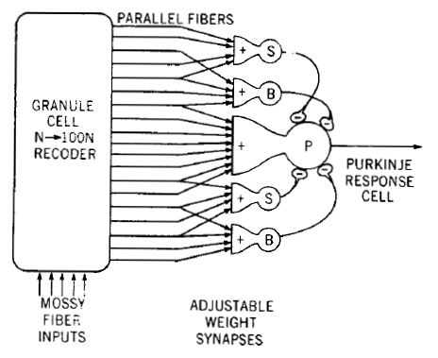


Single-layer “Perceptron”
= linear decision surface
(Rosenblatt, 1958)
1956 : Minksy and McCarthy
Dartmouth Conference = Birth of “AI”
Threshold Logic Unit
(McCulloch & Pitts, 1943)
Linear model, threshold activation function
Widroff and Hoff (1960)
ADALINE + gradient descent
training rule = least squares
…
Minsky & Papert (1969)
Perceptron : Only solves linearly separable problems
1976 : Lighthill Report on AI
“fails to address real world problems”
Marr (1969), Albus (1971)
Cerebellar Perceptron

Slide 26
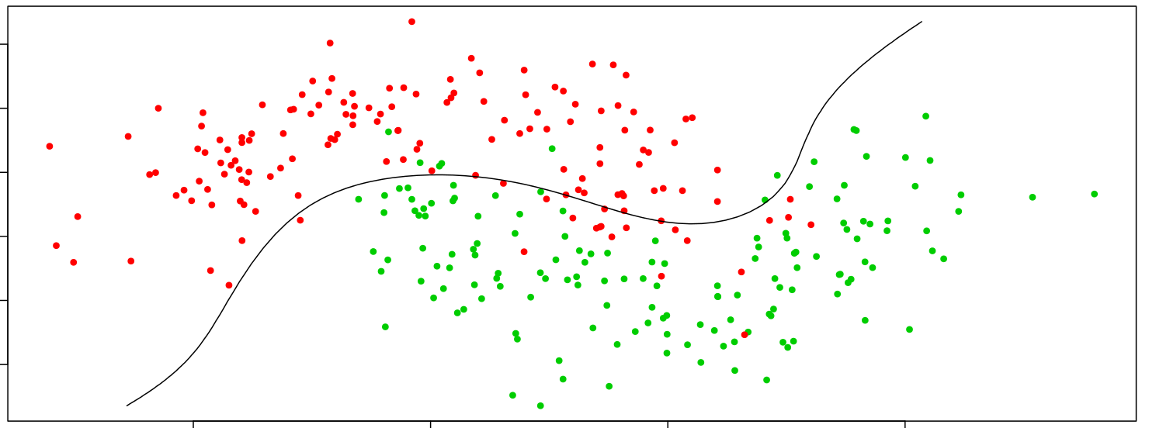
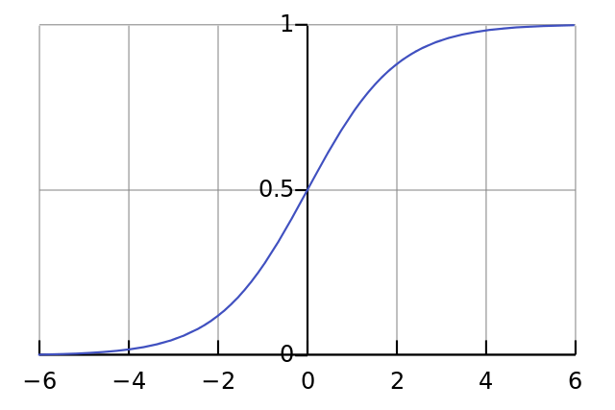
Rumelhart, Hinton, Williams (1986)
Multilayer Perceptron = non-linear decision surfaces
Late 1980s – mid 1990s
Universal function approximation “Cybenko theorems”
Unification of theory with statistics / regression
Support Vector Machines (Cortes & Vapnik, 1995)
Probabilistic / Generative networks
  ‘Harmonium’ (Smolensky, 1986)
  Helmholtz Machines (Hinton et al, 1995)
Growth in “Data mining”
Backpropagation
(Werbos, 1973)
Sigmoid activation
Techniques for
very large feature
spaces
Early 2000s
Statistical learning (regression, classification, clustering)
Applied to biomarkers including
  MRI
  Genomics
  Clinical data
Currently:
Can learn to predict disease states / diagnosis from high-dimensional data
Renewed interest in combining prediction
Late-2000s
GLMnets (Friedman, Hastie, Tibshirani, 2008)
Deep-learning (rebirth of multilayer networks) with rectified linear activation

